Slide 1
Safety Matters in Conducting Laboratory
Physics department GTA briefing & lab conducting, Part II

Slide 2
Safety orientation for PG students
Taking courses
Learn by yourself
http://www.ab.ust.hk/hseo/
The first page of the SCF (Safety Clearance Form) should be returned to DSO (Departmental Safety Officer T.K. Cheung Room 4124) for record just after the Safety Orientation (included in PHYS6770), and the rest of it should be handed-in within two weeks.
Campus Safety Orientation:
  http://www.youtube.com/watch?v=jxrBzWPQqQM&feature=youtu.be

Slide 3
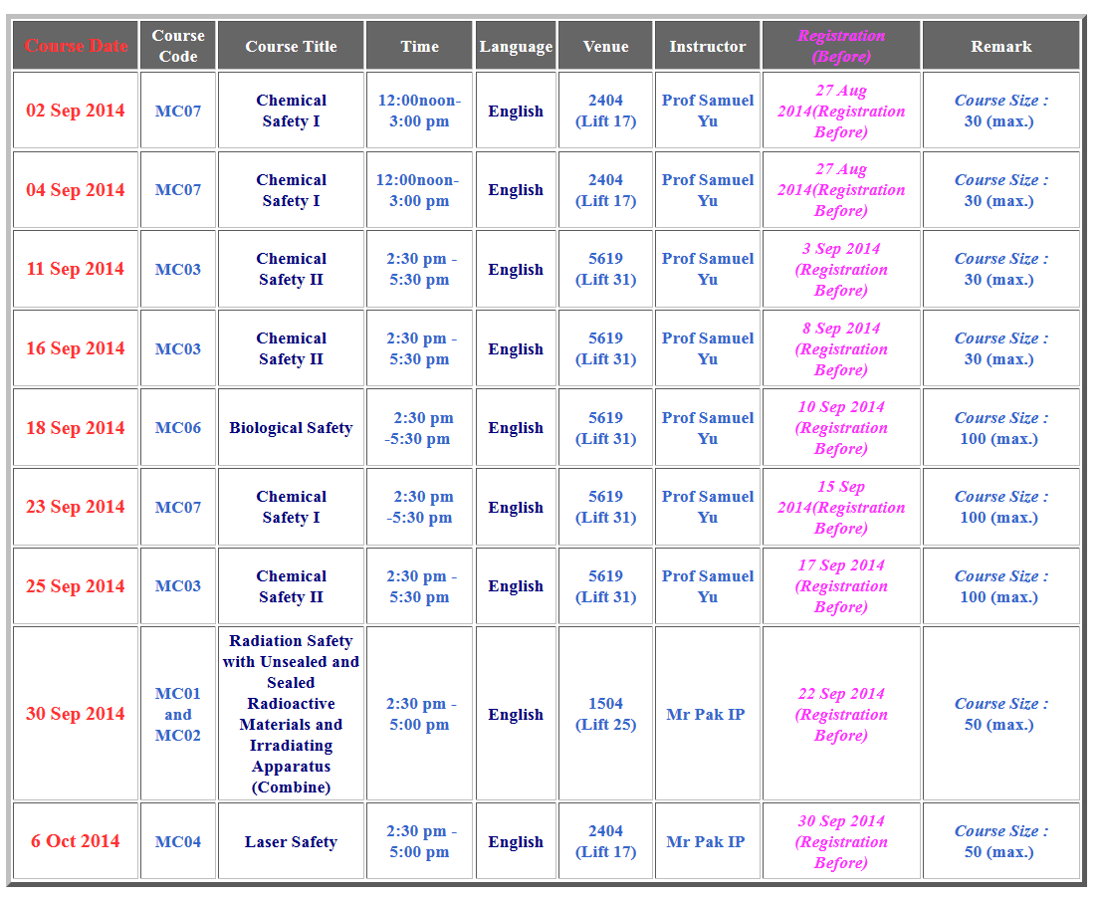

Slide 4
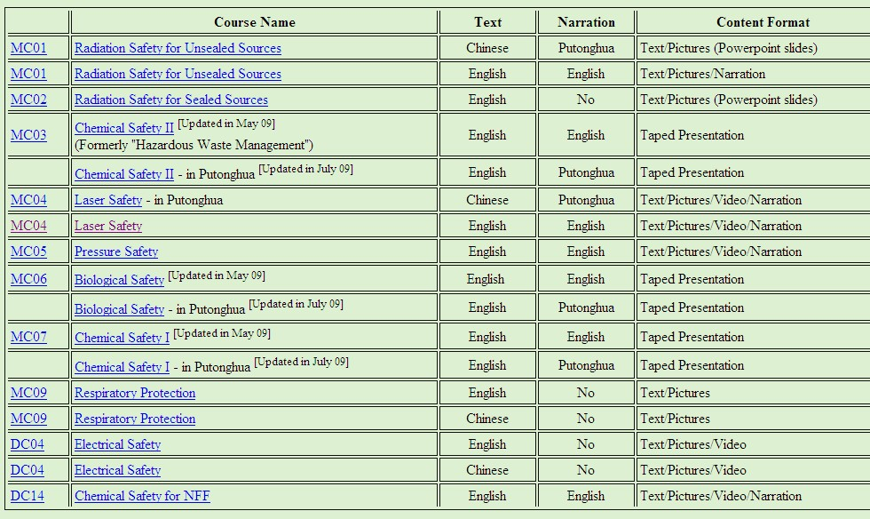

Slide 5
Safety Training
The Safety Training Courses relevant to his/her work should be picked by the Supervisor.
The Safety Training Courses can be amended upon changing of the nature of the PG work.
http://web.phys.ust.hk/
  Physics Intranet → Safety matters in physics

Slide 6
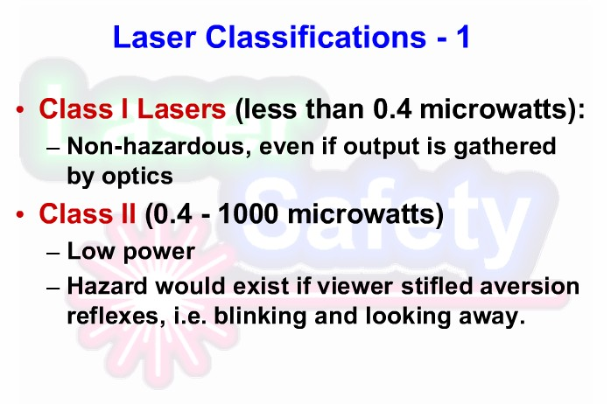
Appendix—— Laser and Radiation Safety

Slide 7
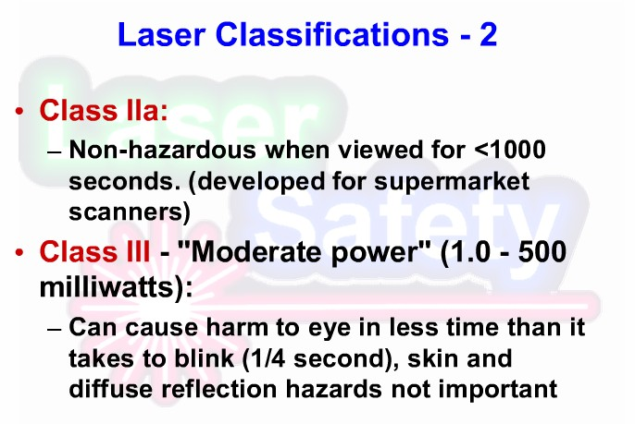
Appendix—— Laser and Radiation Safety

Slide 8
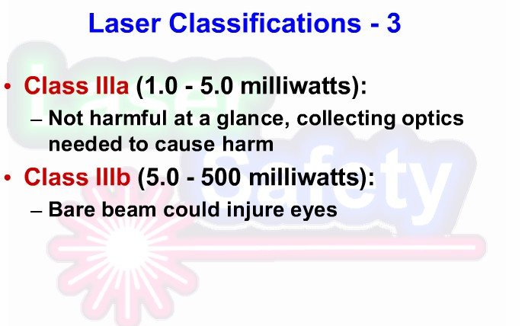
Appendix—— Laser and Radiation Safety
Notes:
Laser pointers can be Class IIIb

Slide 9
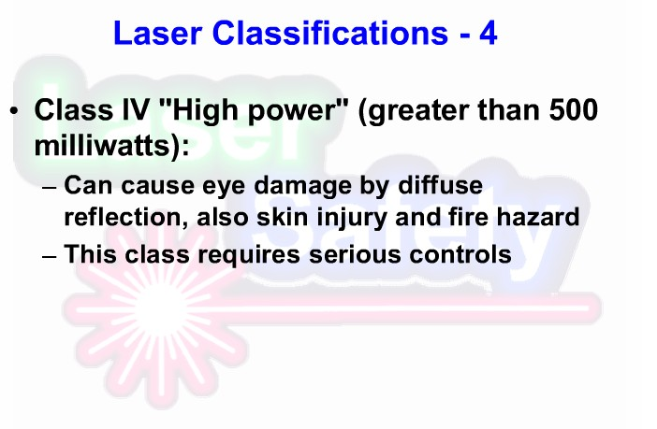
Appendix—— Laser and Radiation Safety

Slide 10
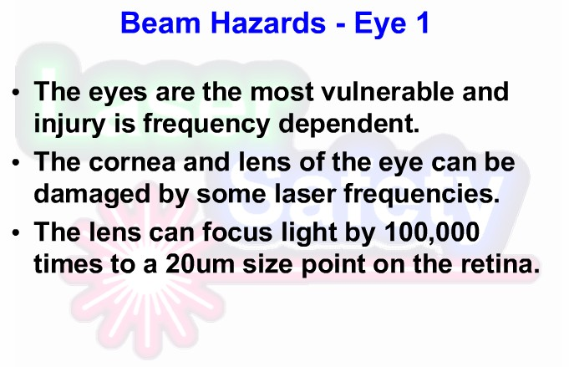
Appendix—— Laser and Radiation Safety

Slide 11
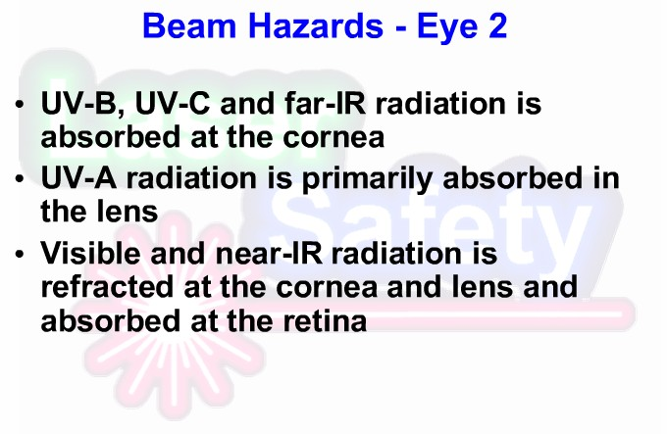
Appendix—— Laser and Radiation Safety
Notes:
IR: infrared radiation

Slide 12
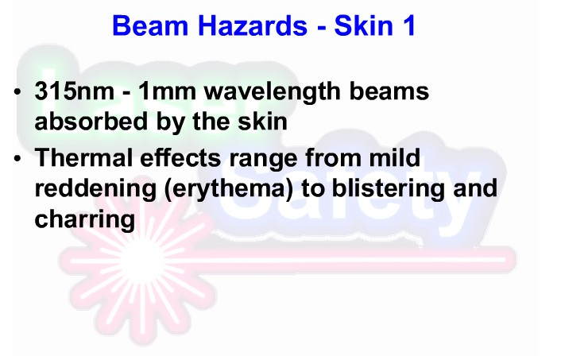
Appendix—— Laser and Radiation Safety
Notes:
Erythema: 红疹
Blistering: 起水疱
Charring: 炭化

Slide 13
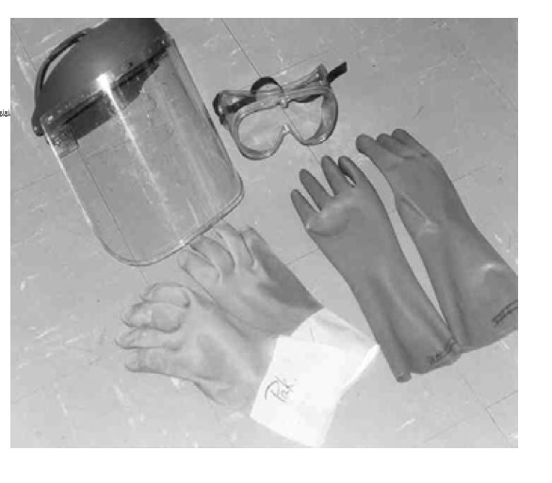
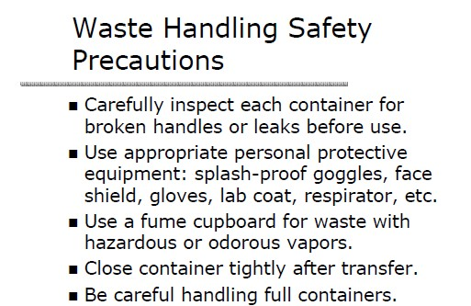
Appendix —— Hazardous Waste Management

Slide 14
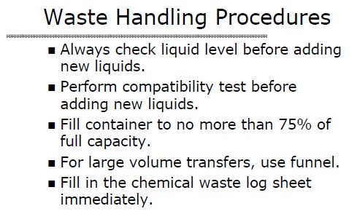
Appendix ——Hazardous Waste Management

Slide 15
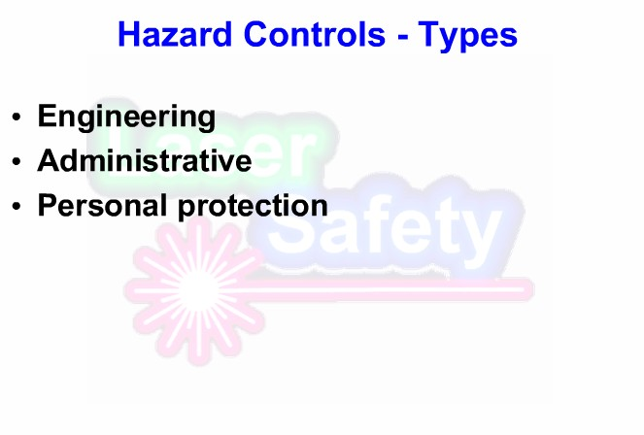
Appendix —— Hazardous Waste Management

Slide 16
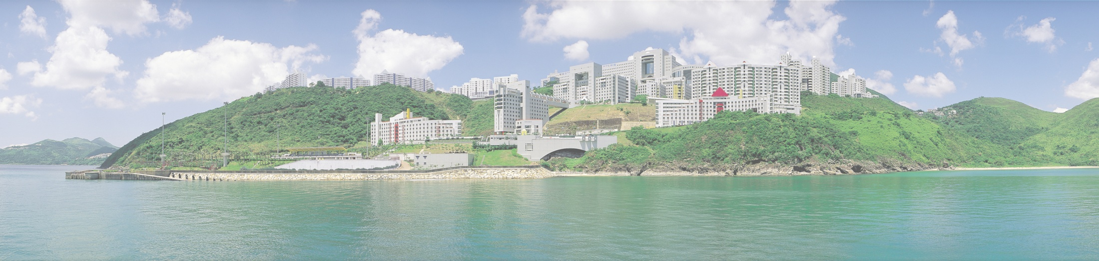
Thank you!
Reminder
Make sure that you have taken your belongings and signed your name before you leave.

